Slide 1

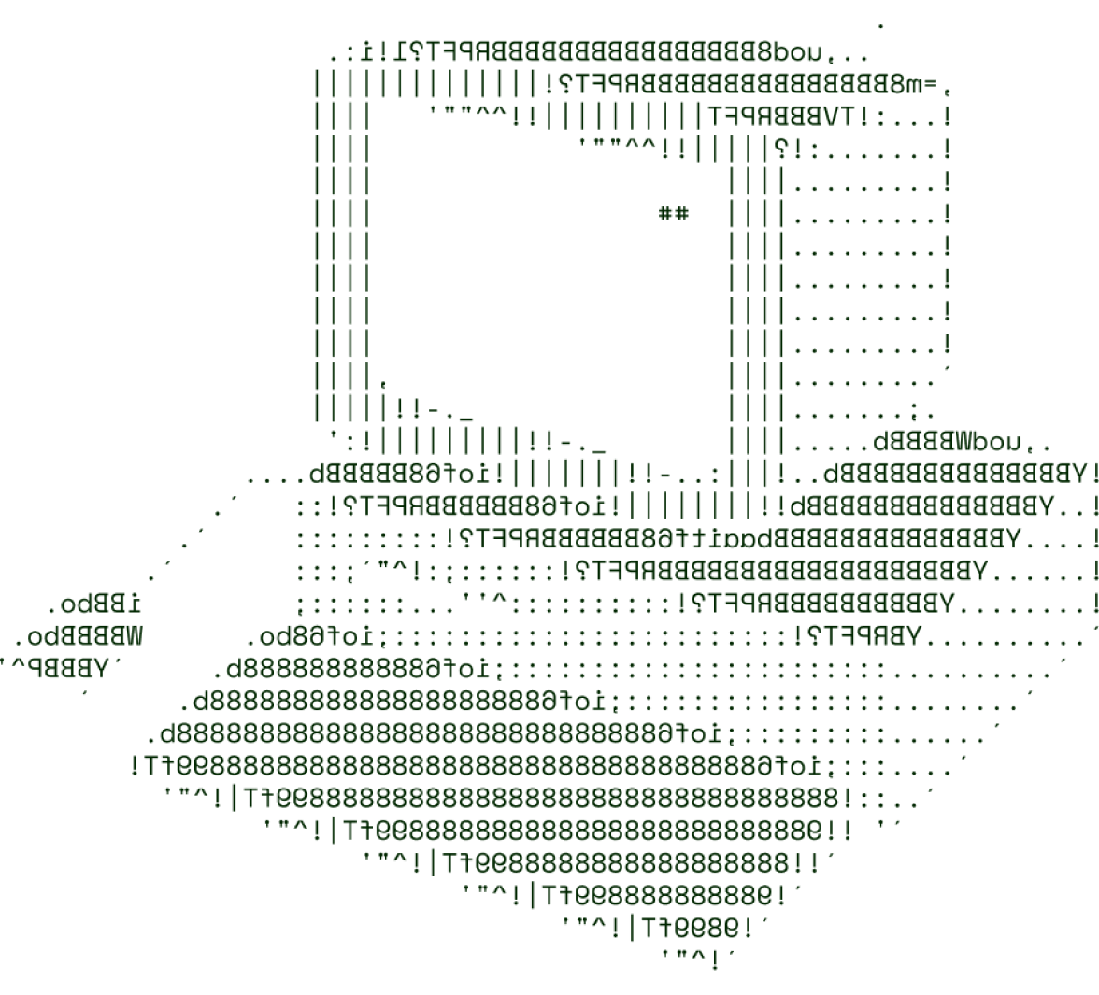

> Harvest Harmony
(Team Phoenixes)

Slide 2

SOLUTION OVERVIEW
We are creating a web application to help farmers easily explore and use NASA's Earth data to improve their farming.
The web app will have a simple design, making it easy for farmers of all skill levels to access and understand important data.
Farmers will get real-time information on weather, soil moisture, and plant health to make better decisions.
Interactive maps and charts will show key trends, making it easier for farmers to connect the data to their practices.
The app will provide personalised suggestions based on individual farm data to help optimise farming methods.
Additionally, it will support a community where farmers can ask questions and share experiences for mutual learning.

Slide 3
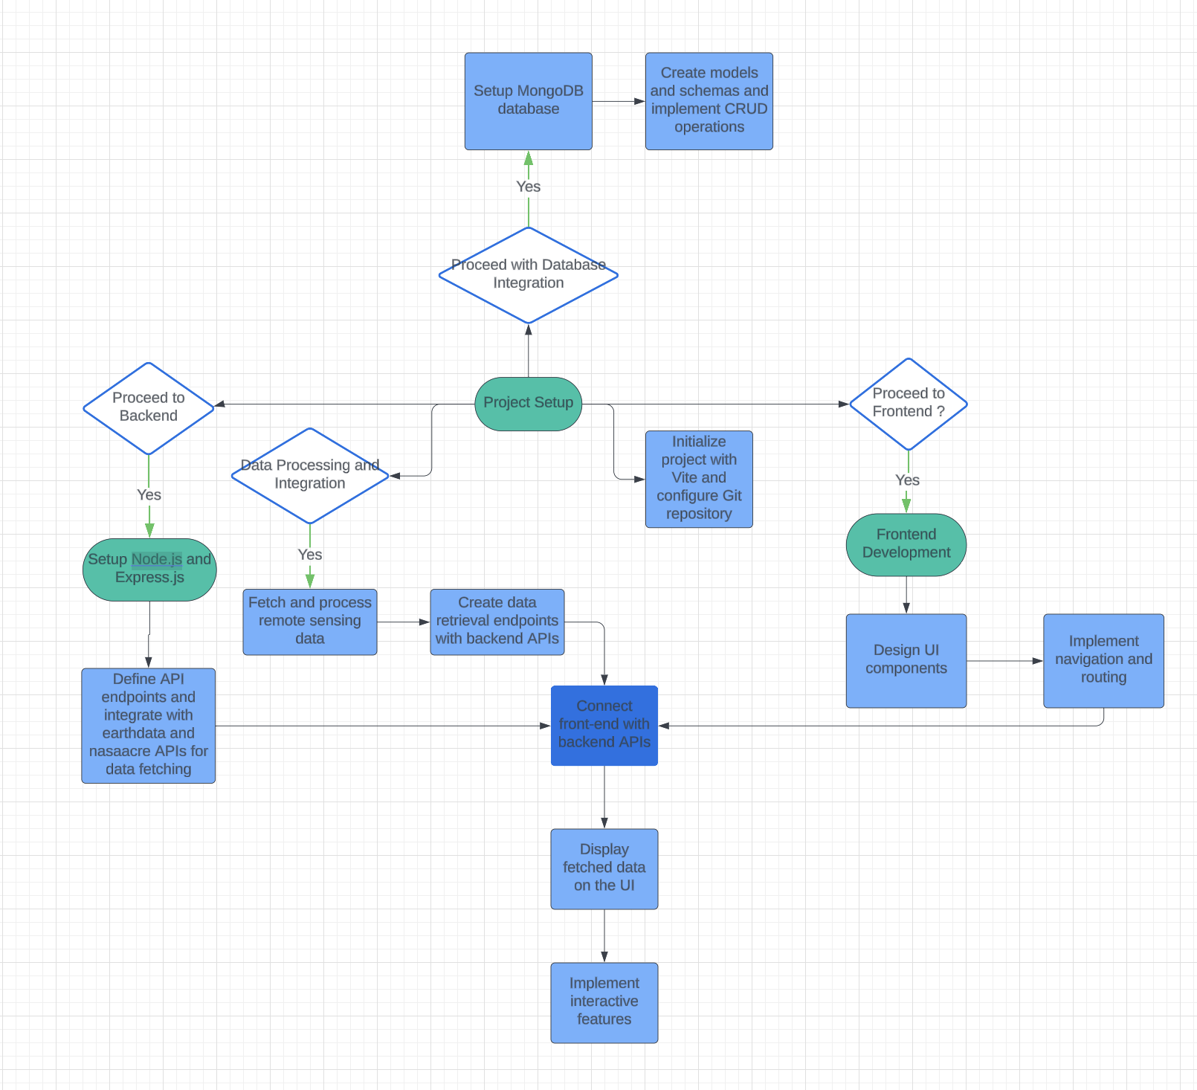
TECHNICAL ARCHITECTURE
Flowchart ->
Tech stack
Frontend Technologies: (React, shadcn/ui(components), TailwindCSS)
Backend Technologies:(Node.js, Express.js)
Database:(MongoDB)
Other Tools/Services:(Docker, earthdata(API), nasaacre(API), Git, vite)

Slide 4
SCALABILITY AND FUTURE SCOPE
Scope: The tool aims to integrate NASA's extensive Earth observation data to address critical water-related challenges, including droughts and floods, enhancing farmers' decision-making processes.
Feasibility: Leveraging existing NASA datasets (e.g., soil moisture, precipitation) ensures a solid foundation, while a user-friendly interface will facilitate access for farmers with varying technical skills.
User-Centric Design: By focusing on farmers’ real-world needs, the tool can provide personalised insights, fostering better resource management and crop health outcomes.
Data Integration: Combining satellite data with farmers' field observations will enable richer analyses, allowing for localised insights and actionable recommendations.
Community Empowerment: The platform can facilitate a knowledge-sharing ecosystem, connecting farmers with experts and peers, thus promoting collective resilience and adaptability.
Long-Term Impact: By improving access to reliable data and insights, the tool can enhance food security, promote sustainable agricultural practices, and mitigate the effects of climate change on farming.
Note: You are free to customise the template, but make sure to
include all the requested points.

Slide 5
FEASIBILITY
Access to Data: NASA’s existing datasets on precipitation, soil moisture, and vegetation health are freely available, making it easy to incorporate reliable data into the tool.
User-Friendly Design: The tool can be designed with an intuitive interface that allows farmers to easily navigate and understand the information without requiring technical expertise.
Customisation Options: The tool can be tailored to meet the specific needs of different farming communities, ensuring relevance to various crops and local conditions.
Integration with Existing Tools: It can work alongside other farming technologies, such as mobile apps and IoT devices, allowing for a seamless user experience.
Training and Support: Providing straightforward tutorials and support resources can help farmers learn how to use the tool effectively, enhancing adoption.
Pilot Testing: Initial testing in select farming communities can provide valuable feedback, helping to refine the tool before wider rollout.
Note: You are free to customize the template, but make sure to
include all the requested points.

Slide 6

>Team Details

Slide 7




Ch. Sai Sriram Karteek
Amitabha Nath
Student
VIT-AP University
Student
VIT-AP University
Surya Tejass
Student
VIT-AP University

Slide 8

Thanks for Joining

